Slide 1

Containerization and Cloud-Native Applications: Transforming Modern Software Deployment
Presented by:
Y.BHAVYA SRI (192524153)
CSA1511 :CLOUD COMPUTING AND BIG DATA ANALYTICS
Date: 20/07/2026
Technical Presentation

Slide 2
Introduction
What is Containerization?
Containerization packages an application with all its dependencies.
Containers run consistently across different environments.
Popular container platform: Docker.
What are Cloud-Native Applications?
Applications designed specifically for cloud environments.
Built using microservices, containers, APIs, and automation.
Easily scalable and highly available.

Slide 3
Core Technical Explanation
Container Architecture
A container includes:
Application Code
Runtime Environment
Libraries
Configuration Files
Dependencies
Unlike virtual machines, containers share the host operating system kernel, making them lightweight and faster.
Working Process
Developer → Docker Image → Container Registry → Kubernetes Cluster → Running Application

Slide 4
IoT-Cloud Architecture
Components
1. Application Code
Business logic and source code
2. Docker Image
Stores application and dependencies
3. Container Runtime
Executes containers
4. Kubernetes Orchestrator
Deploys, scales, and manages containers
5. Cloud Platform
AWS, Microsoft Azure, Google Cloud

Slide 5
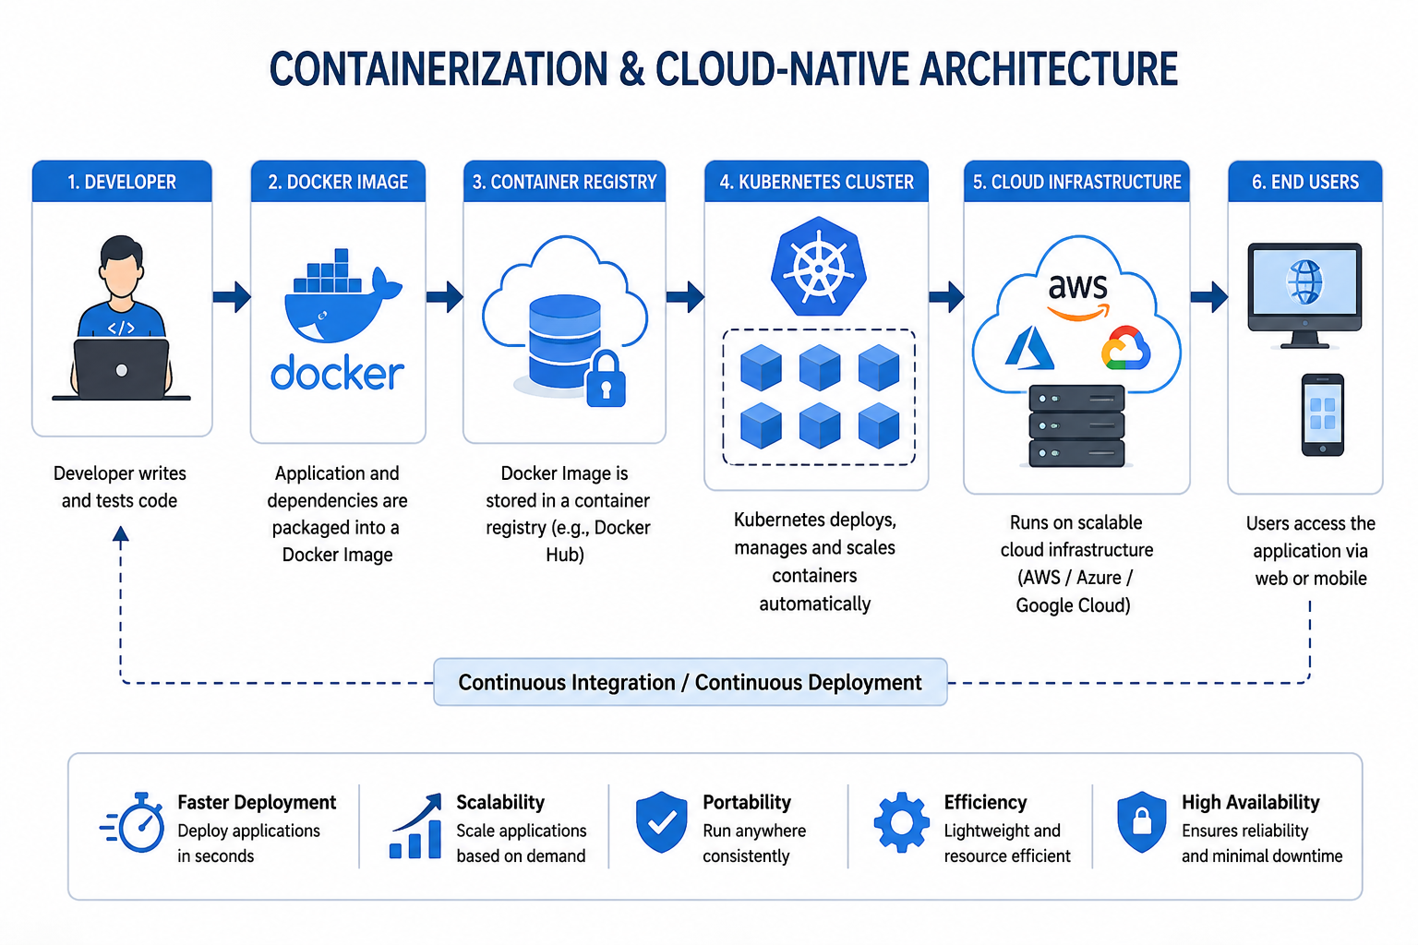
Architecture Diagram

Slide 6
Benefits of IoT and Cloud Integration
Portability
Runs on any platform without modification.
Faster Deployment
Applications deploy in seconds.
Scalability
Containers automatically scale according to demand.
Resource Efficiency
Consumes fewer resources than virtual machines.
High Availability
Ensures continuous service with minimal downtime.

Slide 7
Real-World Applications
Netflix
Runs thousands of microservices using containers.
Spotify
Uses Docker and Kubernetes for music streaming services.
Amazon
Deploys cloud-native applications for e-commerce.
Banking
Secure online banking applications.
Healthcare
Electronic Health Record (EHR) systems.

Slide 8
Example Use Case
E-Commerce Website Deployment
Developer ↓ Docker Build ↓ Container Registry ↓ Kubernetes Deployment ↓ Cloud Server ↓ Customer Access
Advantages
Faster software releases
Easy scaling during sales
High reliability
Reduced infrastructure cost

Slide 9
Conclusion and Key Takeaways
Conclusion
Containerization simplifies application deployment and management.
Cloud-native applications improve scalability, reliability, and performance.
Organizations use Docker and Kubernetes to build modern cloud applications.
Key Takeaways
✔ Containers package applications with dependencies.
✔ Docker creates and runs containers.
✔ Kubernetes manages multiple containers.
✔ Cloud-native applications improve scalability.
✔ Widely adopted by modern enterprises.

Slide 10
Limitations and Future Scope
Limitations
Learning curve for Kubernetes.
Security configuration challenges.
Monitoring many containers is complex.
Future Scope
AI-powered container orchestration.
Serverless containers.
Edge computing integration.
Stronger cloud security automation.

Slide 11

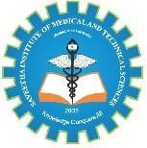
Thank You!!!

